Slide 1
ECOSENSE CITY
SMART CITY PROJECT
Envisioning the Future of Urban Living

Slide 2
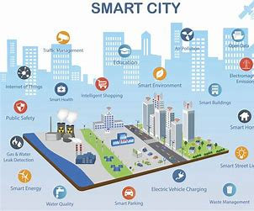
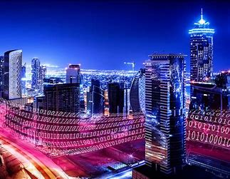
What is a Smart City?
A smart city is a city that utilizes technology and data to enhance the quality of life for its residents. It incorporates intelligent systems to improve infrastructure, public services, transportation, and environmental sustainability.

Slide 3
Key Features of Smart Cities
Smart Infrastructure: Integrated systems for energy, water, and waste management, ensuring efficient resource utilization.
Smart Transportation: Real-time traffic monitoring, intelligent routing, and eco-friendly public transportation.
Smart Healthcare: Personalized healthcare solutions, telemedicine, and preventive healthcare programs.
Smart Education: Innovative learning platforms, personalized learning experiences, and digital libraries.
Smart Governance: Citizen engagement, open data platforms, and participatory decision-making.

Slide 4
Benefits of Smart Cities
Sustainability: Reduced resource consumption, improved energy efficiency, and eco-friendly practices.
Efficiency: Optimization of infrastructure, improved service delivery, and reduced operational costs.
Livability: Enhanced quality of life, improved public safety, and improved social equity.
Economic Growth: Increased competitiveness, job creation, and improved tourism.

Slide 5
The Future of Smart Cities
Ubiquitous Connectivity: The rise of 5G and IoT will enable seamless connectivity and real-time data exchange. Artificial Intelligence and Machine Learning: AI will be used to analyze data, optimize systems, and personalize services. Citizen Engagement: Active participation of citizens in shaping smart city initiatives will be crucial.

Slide 6
Conclusion
We made an website that sustains the future of our planet and tries to implement a new innovation towards a new type of city(Smart Cities) that in the future might help keep the planet safe from global warming and other human-made pollutions.
We tried to implement new design for our website that makes a innovative headstart

